Slide 1
Navigating the Digital Frontier : Exploring Cutting-Edge Technologies and Collaborative Tools
KENAZA Mouataz
RAHLI Zineddine
DJAAFRI Haithem
SAIDOUNI Djoulene
GRAIA Ramin Mohamed Ryad

Slide 2
Introduction
Technologies of Information and Communication have profoundly transformed our perception of the world, how we communicate, and interact with our environment. In this ever-evolving age, these technologies play a pivotal role in various aspects of our personal and professional lives. This digital transformation has significantly impacted societies, economies, and cultures a global scale. This report aims to comprehensively analyze the various facets of these technologies, with a focus on the comparative analysis of services offered by major players such as Google, Microsoft, and Git/GitHub. We will also explore the impact of these technologies in areas such as education, healthcare, industry, and governance, while highlighting emerging trends the challenges associated with their implementation.
By exploring these themes, the report seeks to provide an informed perspective on the growing significance of these technologies in our current future world, while underscoring the opportunities and challenges they present.

Slide 3
Characteristics of Information and Communication Technologies
Evolution of TIC
Impact on society
This section will trace the evolution of TIC from its earliest implementations to its current role as a key element of digital transformation. It will examine their impact on society, their role in innovation and the challenges associated with their widespread adoption.
This sub-section will explore in detail the influence of TIC on society, highlighting the socio-economic, cultural and behavioral changes they bring about.

Slide 4
Introducing TIC services
The integration of pivotal TIC (Technology, Information, and Communication) services like Google, Microsoft, and GitHub takes center stage. These robust services offer a wealth of resources spanning cloud solutions, productivity tools, and cutting-edge collaborative software development platforms. By seamlessly incorporating these TIC services, we position our project to harness scalable infrastructure, optimize workflow efficiency, and ensure streamlined version control and collaborative prowess, elevating our potential for impactful outcomes.

Slide 5

01
Analysis of Google Services

Slide 6
Introducing Google as a technology giant :
Since its founding in 1998, Google has expanded its TIC (Technology, Information, and Communication) services beyond search to encompass email with Gmail, mapping with Google Maps, collaborative document management through Google Drive, and cloud computing via Google Cloud Platform. These services have significantly impacted sectors such as business, education, healthcare, and more, shaping the digital landscape and fostering innovation across industries.
Google's impact on TIC :
Google has had a profound impact on Technology, Information, and Communication (TIC) through its comprehensive suite of services. From search algorithms that revolutionized information retrieval to cloud computing platforms and productivity tools, Google's TIC offerings have redefined how individuals, businesses, and organizations interact with technology, communicate, and manage information. By providing innovative solutions and fostering connectivity, Google has played a pivotal role in shaping the landscape of TIC, empowering users with powerful tools for collaboration, data management, and communication.

Slide 7
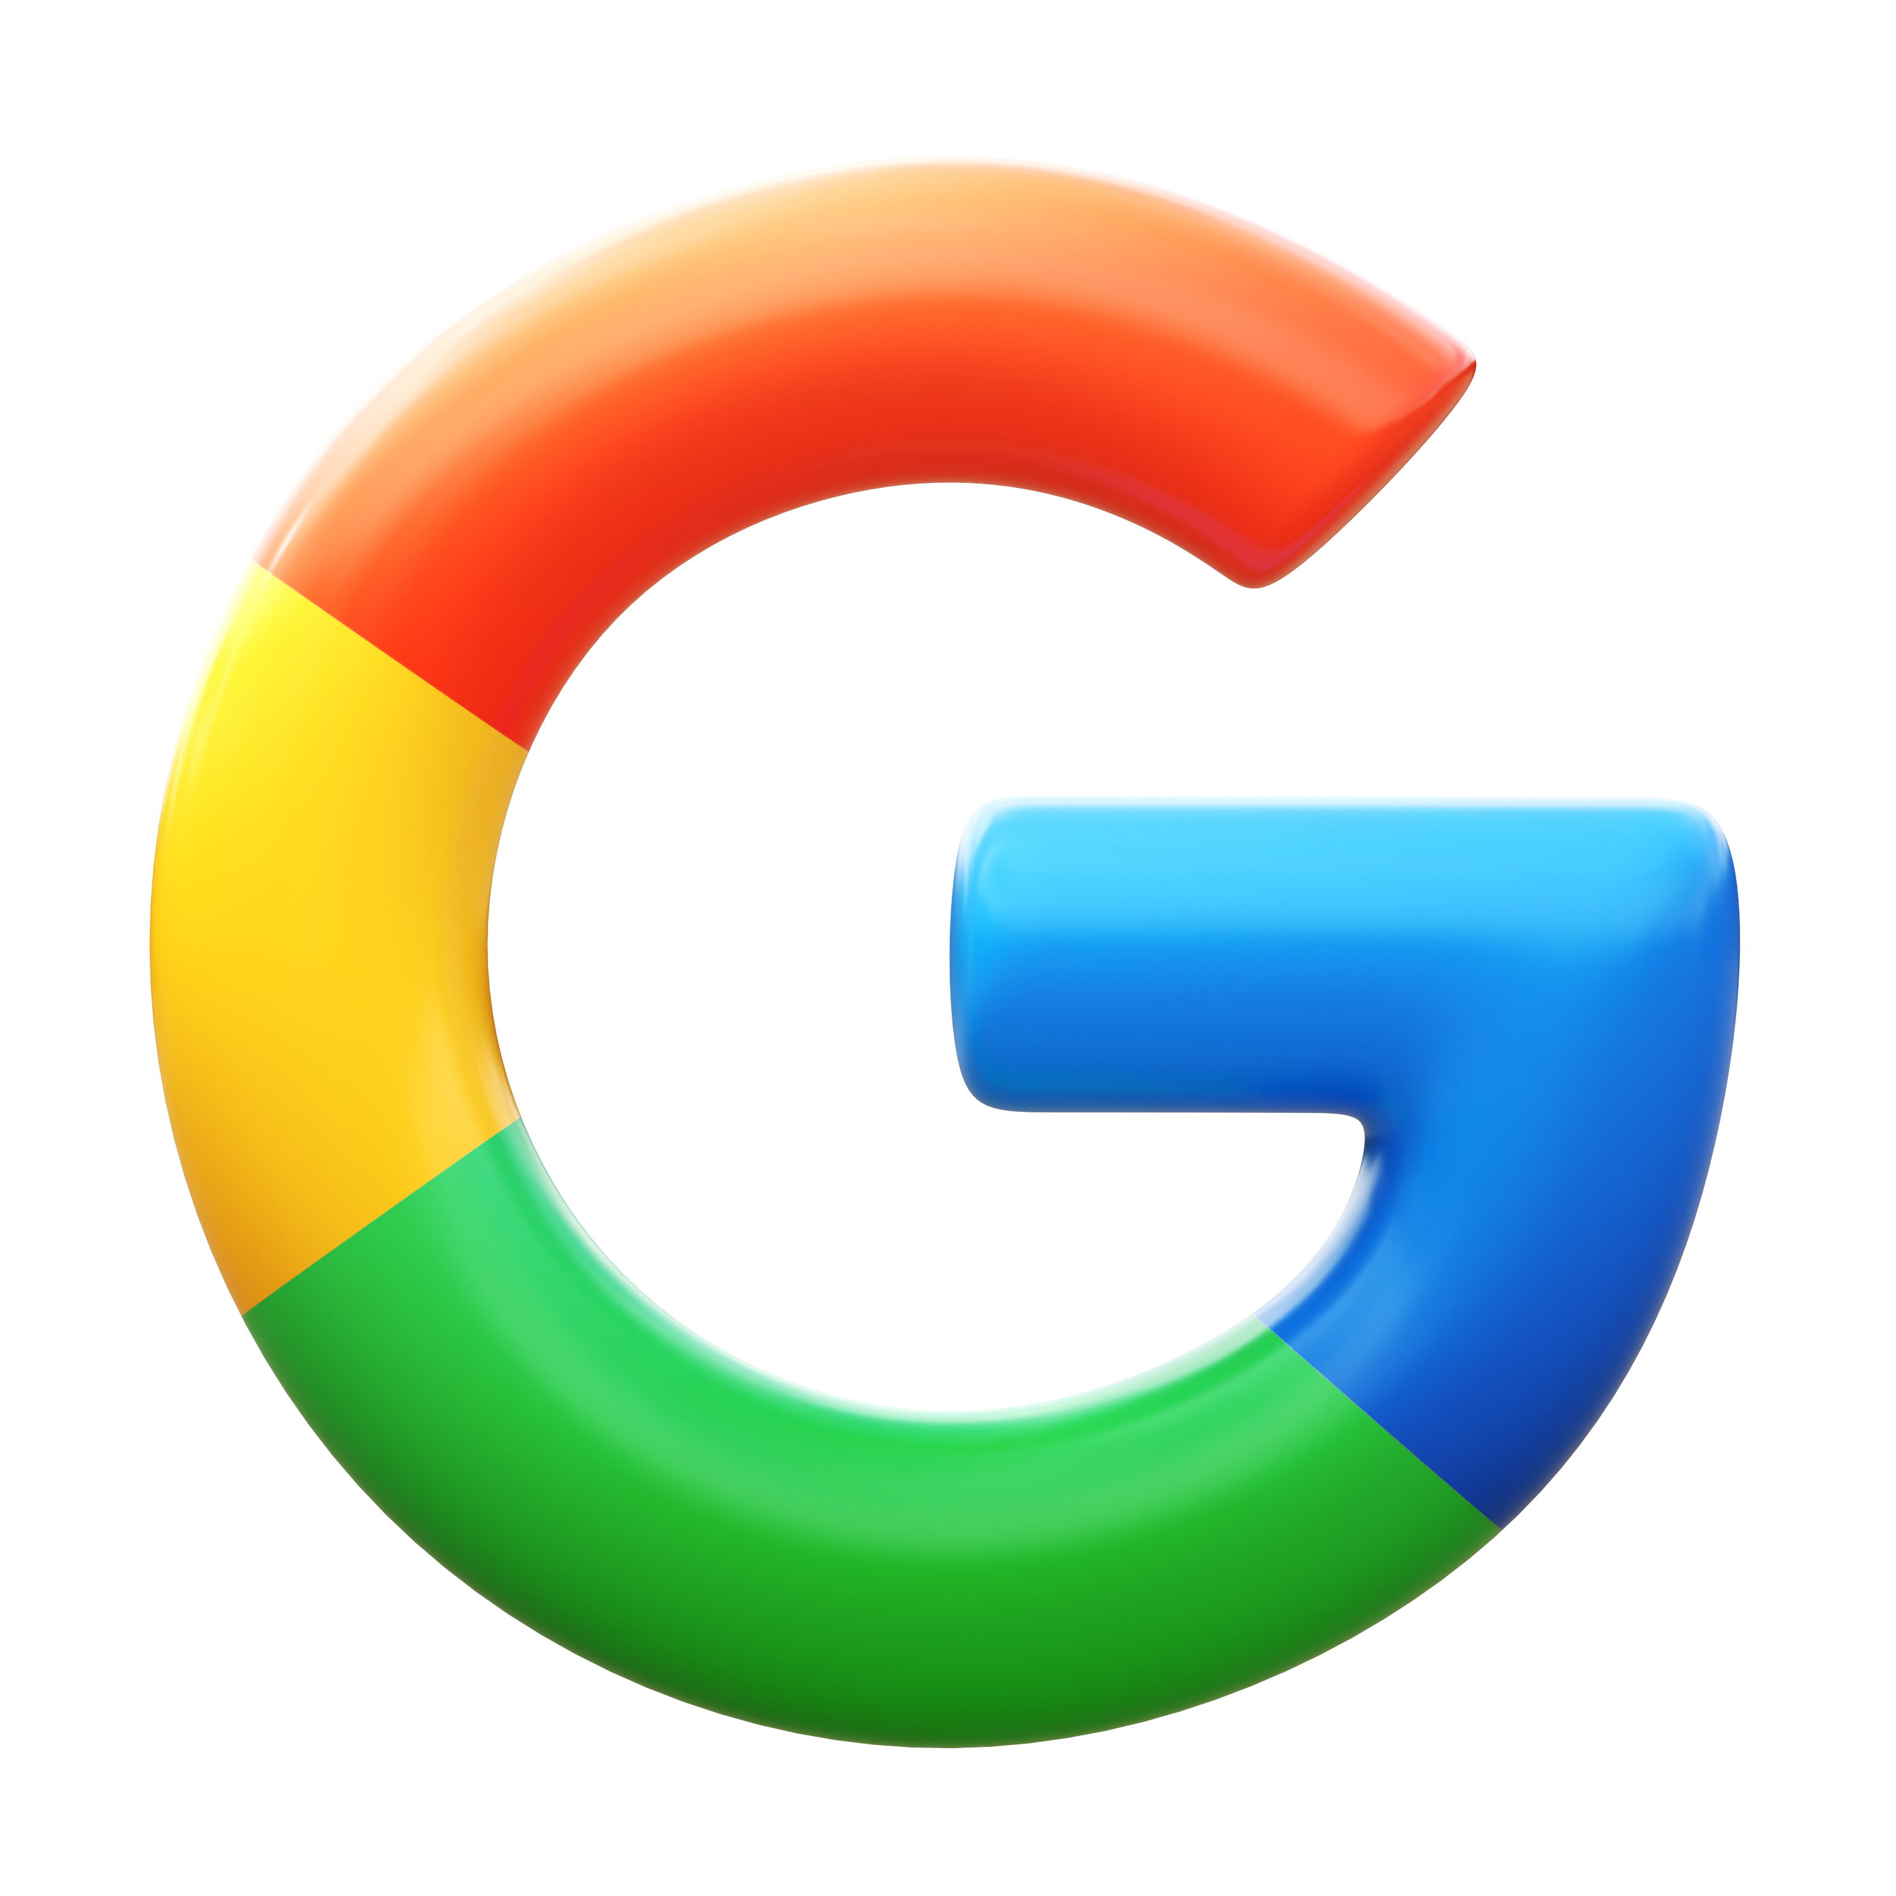
Here is a list of the main services offered by Google :
Google Search
Gmail
Google Drive
Google Docs, Sheets and Slides
A powerful search engine for finding information online.
An e-mail service with a user-friendly interface and large storage capacity.
A service for storing files online and sharing them with other users.
Online office applications similar to Microsoft Word, Excel and PowerPoint, for creating, editing and sharing documents, spreadsheets and presentations.

Slide 8

Google market share (%)
2018
2020
81.63%
81.12%
81.95%
2019

Slide 9
Google market share (%)
2021
2023
82.25%
82.08%
82.42%
2022

Slide 10
Exploring Microsoft Tools
02

Slide 11



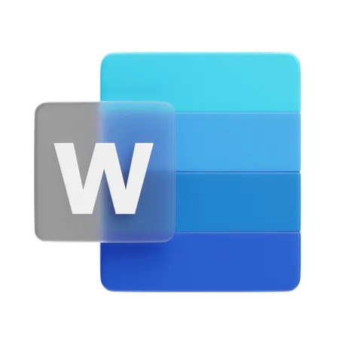
Software applications :
Microsoft Office Suite: Microsoft's Office package includes software such as Word, Excel, PowerPoint, Outlook and OneNote, used by both businesses and the general public for document creation, presentations, e-mail management and more.
Power BI: A data analysis tool enabling companies to visualize and share insights from their data to make informed decisions.
Visual Studio: An integrated development environment (IDE) for creating applications and software solutions.
SharePoint: An enterprise content management platform that makes it easy to store, share and collaborate on documents and information.

Slide 12
Influence on professional and personal life :
Personal environment : Microsoft's software, including the Windows operating system, the Office suite, and entertainment tools like the Xbox, has significantly influenced users' daily lives. Moreover, Microsoft has expanded its reach with products like Skype, catering to personal and business communication needs.
Professional environment : Microsoft Office is a fundamental productivity tool used extensively for document creation, presentations, and email management. Microsoft Teams has also revolutionized teamwork by providing unified communication, file sharing, and real-time collaboration capabilities. In personal environments, Microsoft's impact is felt through its Windows operating system, Office suite, and entertainment tools like Xbox. Additionally, products like Skype cater to both personal and business communication needs.
Contributing to global TIC development :
Strategic partnerships: Microsoft has formed collaborations with prominent technology firms and start-ups, driving innovation in critical domains such as AI, cloud computing, IoT, and cybersecurity.
Investment in research and development: Microsoft has made substantial investments in research and development, particularly in cutting-edge fields like quantum computing, biotechnology, and artificial intelligence, playing a key role in advancing these technologies.

Slide 13
Git/GitHub analysis
03

Slide 14
Understanding Git and GitHub in relation to TIC:
Git is a distributed version control system, which means it allows multiple developers to work on the same source code without interfering with each other. It provides a complete history of code modifications, making it easy to track changes and facilitate collaboration between members of a development team.
GitHub is a collaborative development platform that uses Git for version control. It offers features such as issue tracking, pull requests, wikis and project tracking. GitHub facilitates collaboration between developers by providing a centralized environment for storing, managing and collaborating on software projects.
The impact of Git/GitHub on TIC:
The implementation of Git and GitHub has revolutionized software project management by enabling version tracking, seamless change merging, and enhanced collaboration among developers, significantly improving the efficiency of the software development process.
Integrating Git and GitHub into software development has also enhanced the transparency, traceability, and reproducibility of development processes, essential in the TIC sector where software quality and reliability are paramount.

Slide 15

Key data on GitHub.
Statistics | Value | Source
Number of users | 110 million by 2023 | GitHub Octoverse Report 2023
Number of deposits | 284 million by 2023
Number of contributions | 4,5 billion by 2023
Market share |  | Undisclosed
74%

Slide 16
Emerging trends in TIC:
Emerging trends in ICT are characterized by the rapid evolution of revolutionary technologies such as artificial intelligence (AI), the Internet of Things (IoT), blockchain, quantum computing, virtual reality (VR), and augmented reality (AR). These technologies significantly impact ICT by reshaping data processing, sharing, and usage, presenting new opportunities across sectors such as healthcare, industry, agriculture, and transportation.
Security and Ethical Challenges in TIC Use:
Alongside the benefits, ICT faces major challenges in data security and ethical considerations, given the proliferation of sensitive personal data. This raises concerns about confidentiality, requiring enhanced security measures to address potential threats like cyber-attacks and data leakage. The ethical use of emerging technologies, particularly AI, also raises questions about fairness, transparency, and accountability in deployment, essential for ensuring user trust and sustainable adoption of ICT.
Proactively addressing these challenges necessitates strong governance policies, robust security protocols, and increased awareness of ethical issues, fostering a safe, equitable, and sustainable digital environment in the era of emerging technologies.

Slide 17
Primary ICT Software Usage across Continents
Google: online search, services
Netflix: video streaming service
Kaspersky: cybersecurity
Doctolib: online medical appointment platform
Alibaba: e-commerce
WeChat: messaging, social networking, mobile payment
M-Pesa: mobile money transfer service
Udemy: online learning platform

Slide 18
Conclusion
After a comprehensive analysis of Google, Microsoft, and Git/GitHub services, it is evident that these information and communication technologies (ICT) hold pivotal significance in today's digital sphere. Each platform offers distinct advantages and robust features for users. However, it's crucial to acknowledge that alongside their benefits, these services provoke valid concerns regarding privacy, security, and conscientious data handling. Addressing these concerns is of utmost importance for individuals and organizations, emphasizing the need for ethical and secure utilization of these platforms. In conclusion, prudent management of these technologies is paramount. Users must gain an understanding of the advantages and risks associated with these services, and institute best practices to ensure responsible and ethical utilization of information and communication technologies.

